Slide 1
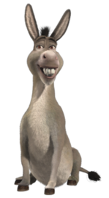
CyberGuard Pro
Angel, Victoria, Nicolas (⅚ Marginalized)
Btw Nicholas did the backgrounds, we better get an A

Slide 2

CyberGuard Pro
We’re a locally-owned cybersecurity company aimed at protecting our clients’ data from cyber attacks.
This site should be beneficial to all businesses looking to expand their IT infrastructure.
The global cyber security market size was estimated at USD 222.66 billion in 2023 and is projected to grow at a compound annual growth rate (CAGR) of 12.3% from 2023 to 2030.
Small companies may run their own security in-house, but as they grow, so does the amount of data and varieties of data they become responsible for. To keep up with the demand, they will hire a cybersecurity consulting firm to install and manage software and test their systems to ensure information security.

Slide 3
Issues with Site Design
Outdated Infrastructure, material and content
Overly complicated and too technical for some customers to understand
Needs simplicity for those not knowledgeable about cybersecurity

Slide 4


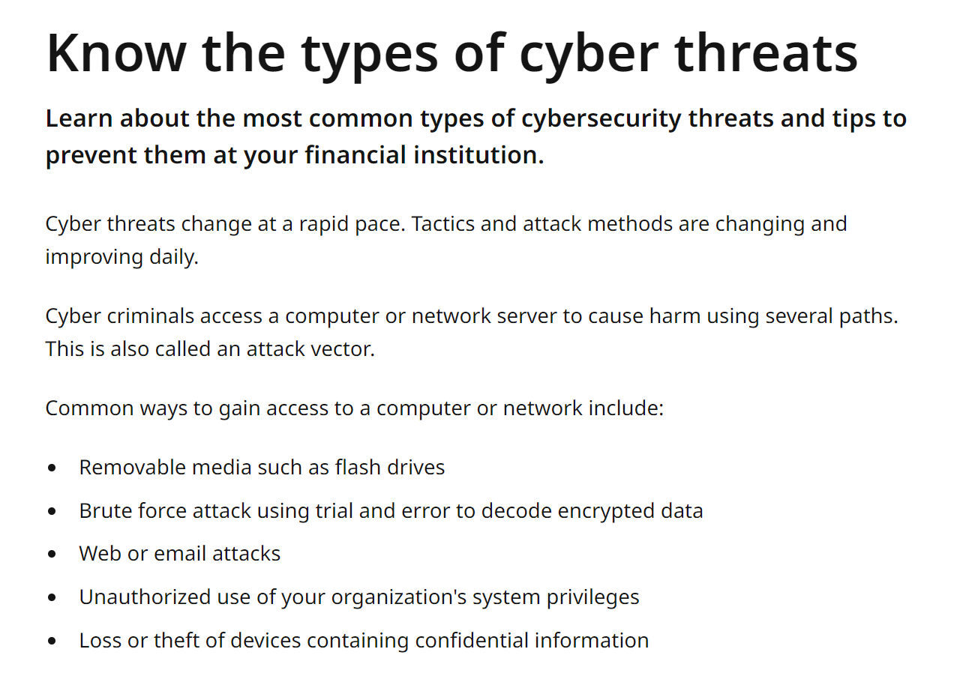
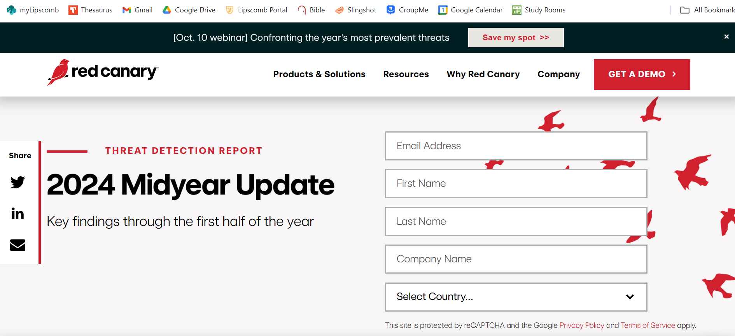
Features of Related Sites
Common cyber threats articles
Service breakdown
Request-a-quote form
Make-Your-Profile
Planning Tools
Simple layouts and formats
Request-a-Quote

Slide 5
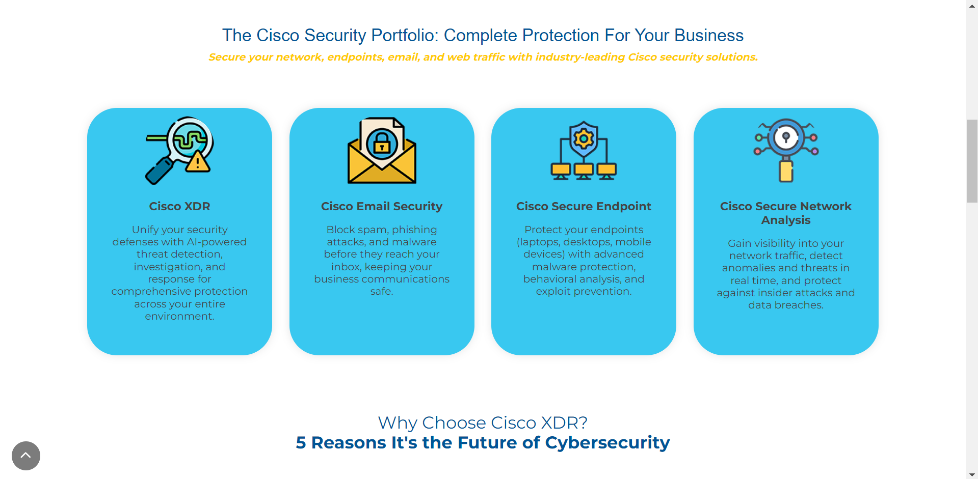
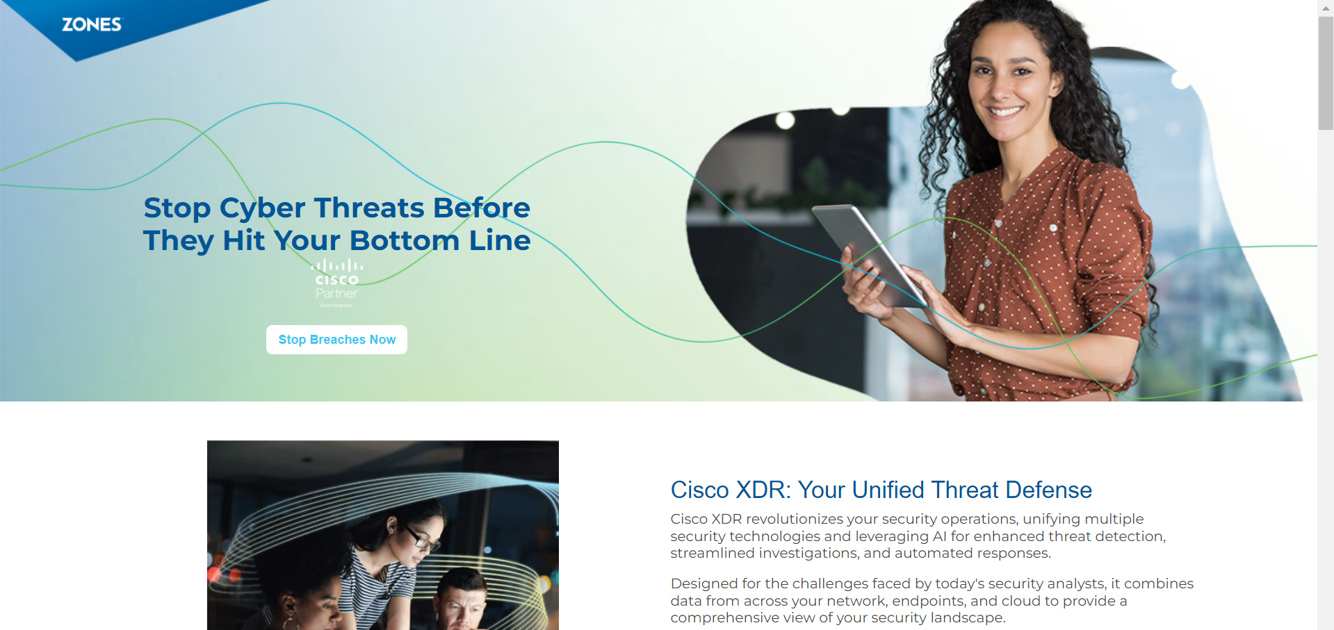
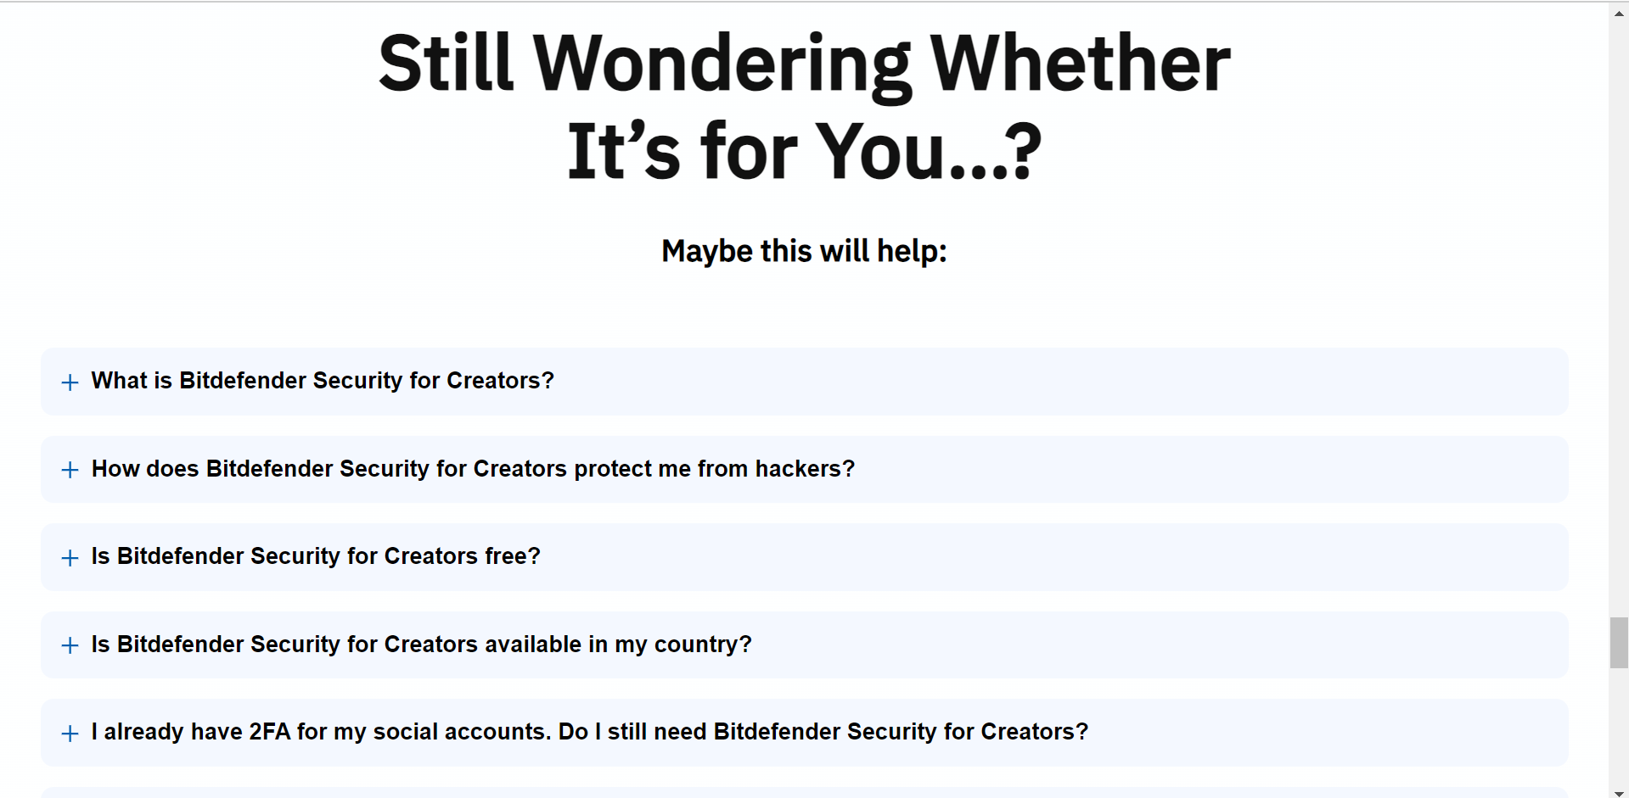

Slide 6
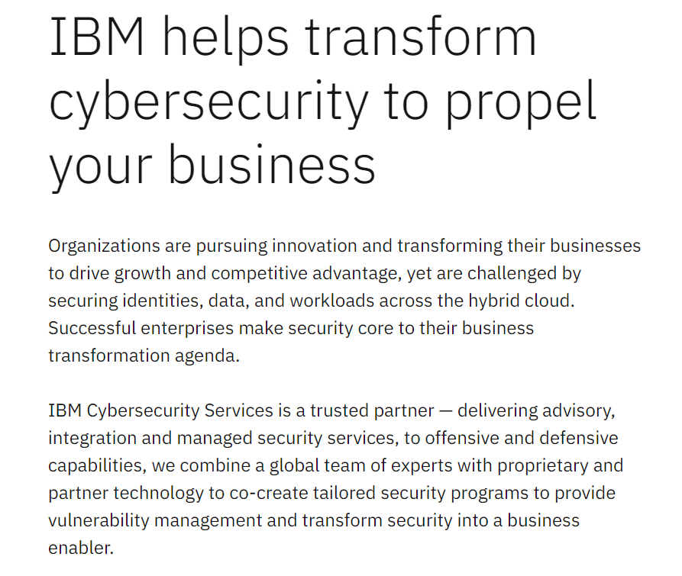
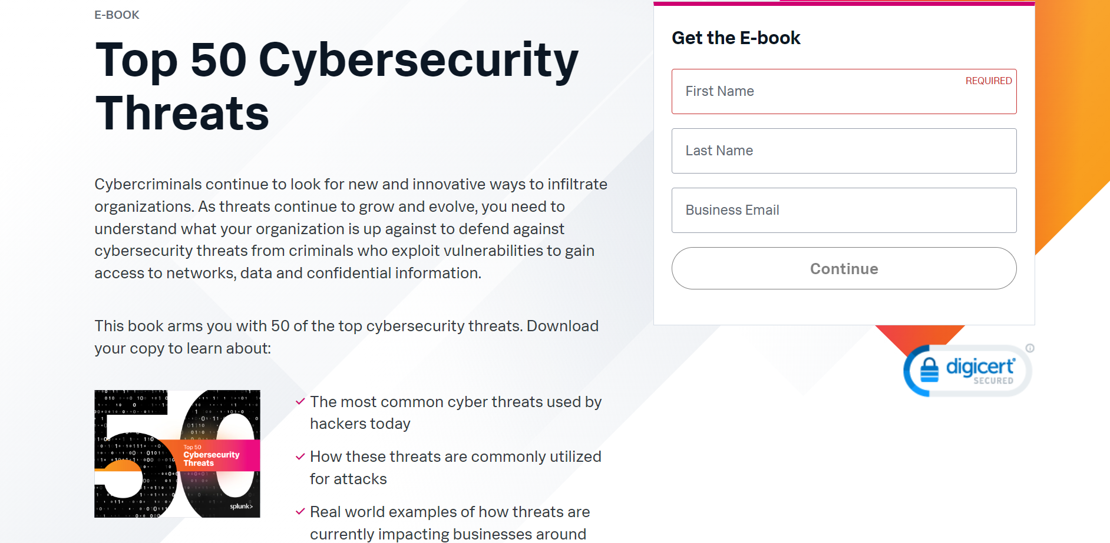
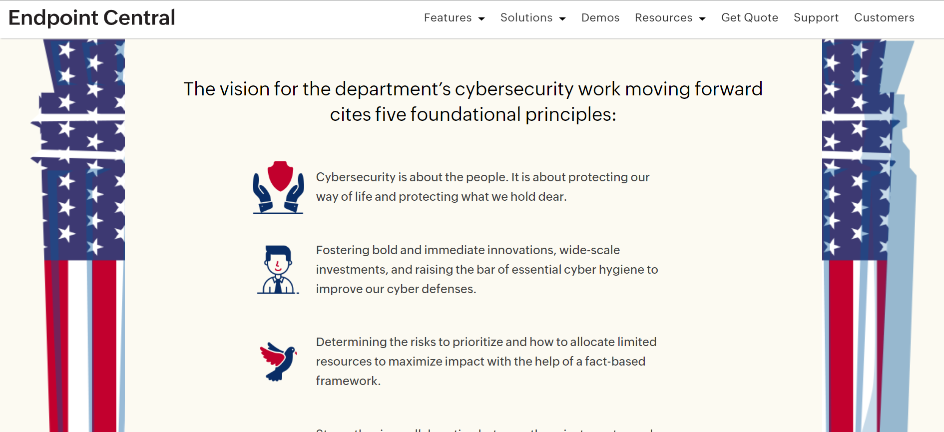

Slide 7

Improvements and Solutions
Blogs to educate on security measures for business owners to follow
Open, flowing pages to avoid cramming of information
Regularly updated content and articles following trends in the security industry
Quizzes for business to assess their security vulnerabilities and needs
Simple formatting and language for customers to understand
Provide a “solutions” tab for security concerns

Slide 8

Works Cited
https://www.intel.com/content/www/us/en/homepage.html
https://www.semperis.com/?utm_medium=pd&utm_source=esecurityplanet&utm_campaign=techadvice-traction
https://www.grandviewresearch.com/industry-analysis/cyber-security-market
https://www.grandviewresearch.com/horizon/outlook/cyber-security-market-size/global
https://www.statista.com/outlook/tmo/cybersecurity/worldwide

Slide 9
Example Sites
https://info.zones.com/cisco-xdr-stop-cyber-threats-protect-your-business?utm_term=cyber%20security%20threats&utm_campaign=Q3-Cisco+XDR-24&utm_source=adwords&utm_medium=ppc&hsa_acc=2479251831&hsa_cam=21691655199&hsa_grp=170410990467&hsa_ad=713380211170&hsa_src=g&hsa_tgt=kwd-10699993641&hsa_kw=cyber%20security%20threats&hsa_mt=e&hsa_net=adwords&hsa_ver=3&gad_source=1&gclid=Cj0KCQjwjY64BhCaARIsAIfc7YaLr-nIBqQ7dS7Tw-hH-1JTz76i0nhzN_oCPpkKemn_Q5iKYIZDKlAaAvL8EALw_wcB
https://www.mass.gov/info-details/know-the-types-of-cyber-threats
https://www.kyndryl.com/us/en

